Slide 1
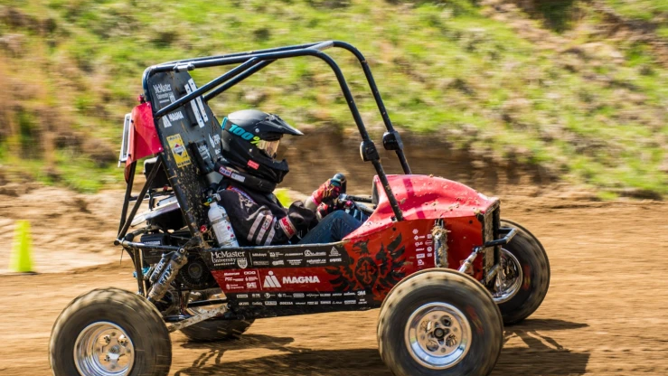

CVT – Simulator
Team 17

Slide 2
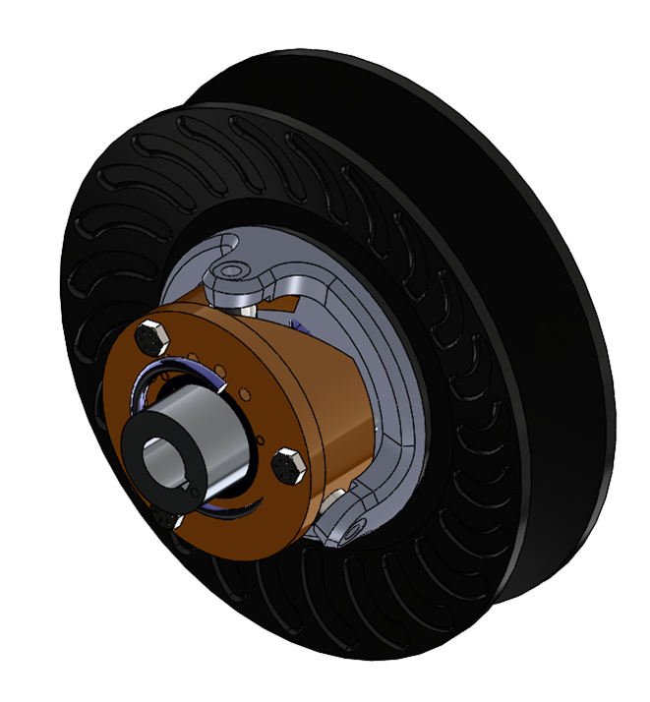
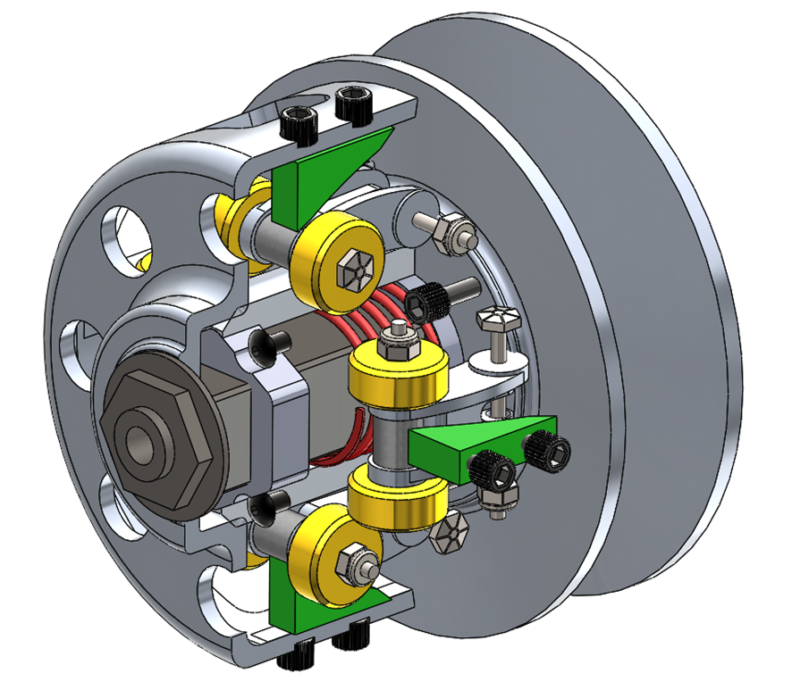

Overview
Current Problem: McMaster Baja currently CVT tuning process is time-consuming and inconsistent due to physical testing.
Our Goal: Develop a simulation tool to virtually tune CVT parameters and test their impact. To thus figure out the optimal tuning parameters and improve vehicle acceleration and hill-climbing performance.

Slide 3

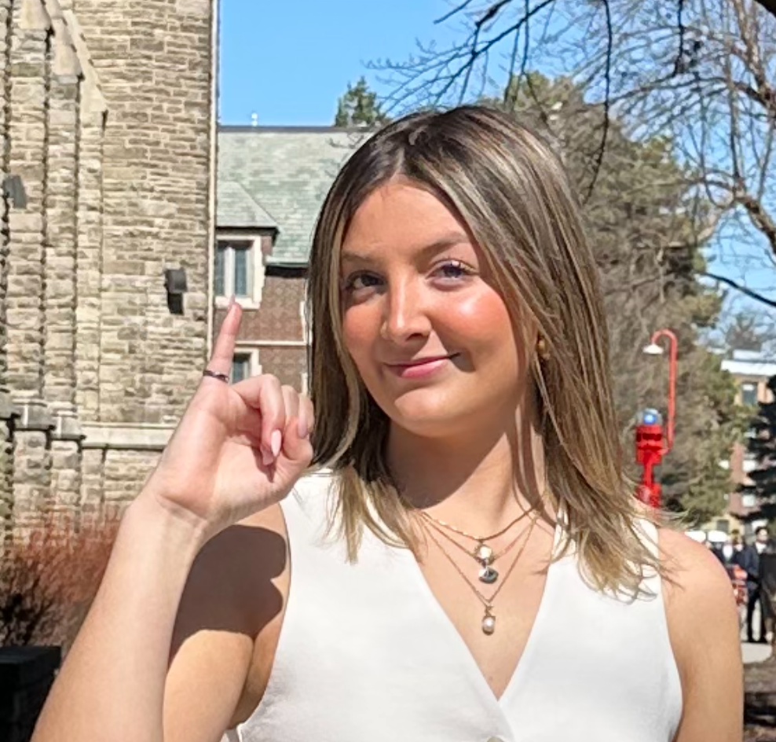
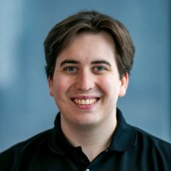
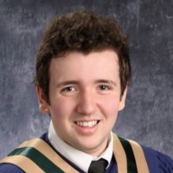
Team Members
Grace McKenna
Travis Wing
Cam Dunn
Kai Arseneau
Our Supervisor: Dr Spencer Smith

Slide 4
Objectives and Features
Simulate CVT system behaviour using mathematical models
Create a 3D visualization of the CVT system
Enable users to test tuning parameters
Allow users to playback the simulation
Provide accurate, validated output data for performance analysis
Allow users to save and export data from the software

Slide 5
Demo

